Slide 1

Team Shipping Kiosk
CS 3354.004
Aashna Pathi, Ann Jayan, Cristina Adame, Namra Zubair, Nivedha Sreenivasan, Sanjana Kotha, Shashi Rajesh, Susan Zhang

Slide 2
TABLE OF CONTENTS
01
02
03
04
05
06
OBJECTIVE
COST ESTIMATION
PROJECT TIMELINE
SOFTWARE REQUIREMENTS
SOFTWARE DESIGN ARTIFACTS
UI DEMO

Slide 3

01
OBJECTIVE

Slide 4


INTRODUCTION
PROJECT GOALS
PROJECT MOTIVATIONS
Creating a software for postal offices that streamlines the shipping process
Stretch goal: deploying kiosks in popular public establishments
Stemmed from our own personal frustrations with the postal office
Current self-service kiosks are complex and often out of service
Inspired to create a self-service software due to its popularity – in terms of both efficiency and safety – post-COVID-19

Slide 5

PROPOSED IMPLEMENTATION
Package Details
Shipping Details
Payment
Additional Notary Service
Help Button

Slide 6
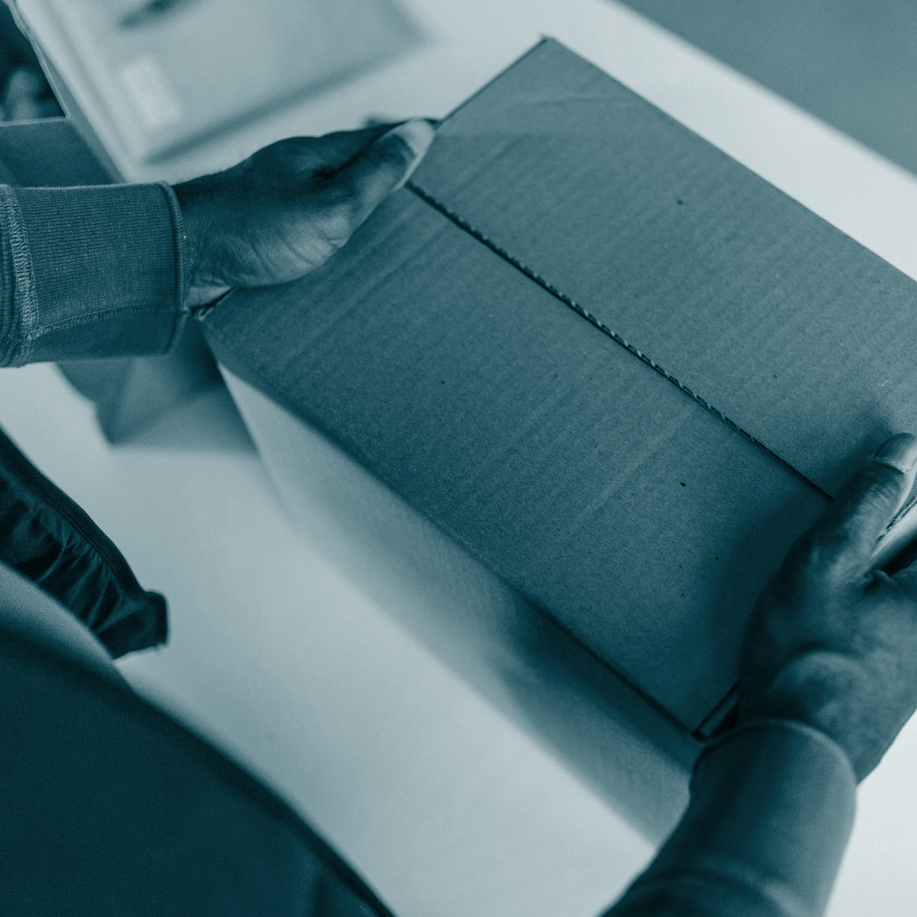
02
COST ESTIMATION

Slide 7
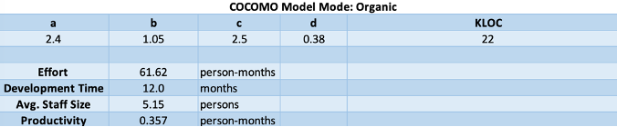
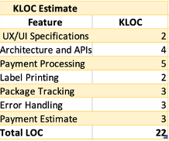
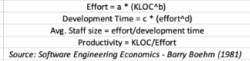
COST, EFFORT AND PRICING ESTIMATION
An algorithmic cost model - COCOMO (Organic Mode) will be used to provide structured estimates based on the project size and complexity. Below is a projected estimate:
Notes:
namra

Slide 8
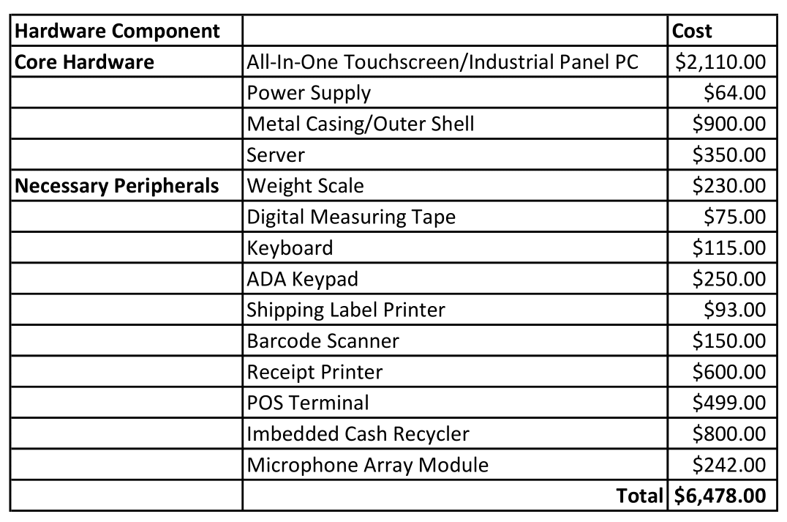
ESTIMATED COST OF HARDWARE PRODUCTS

Slide 9
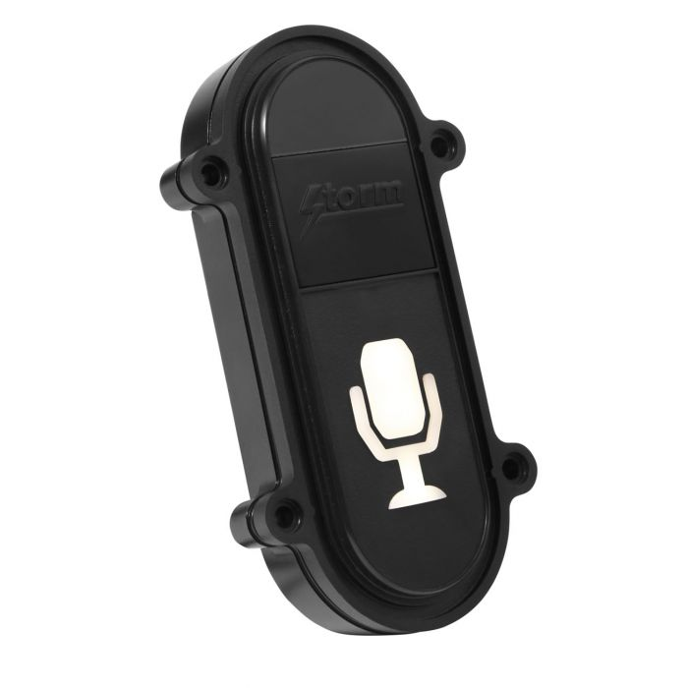
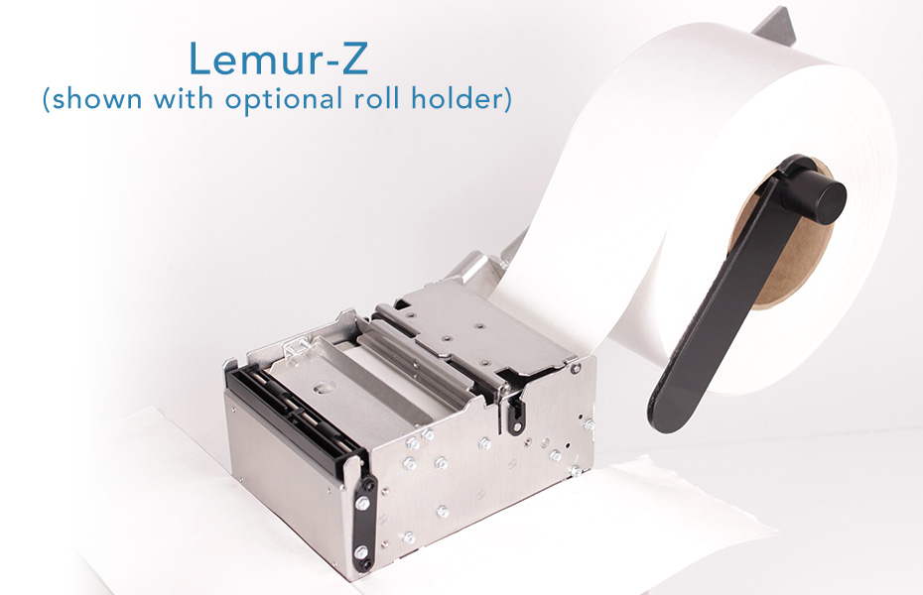
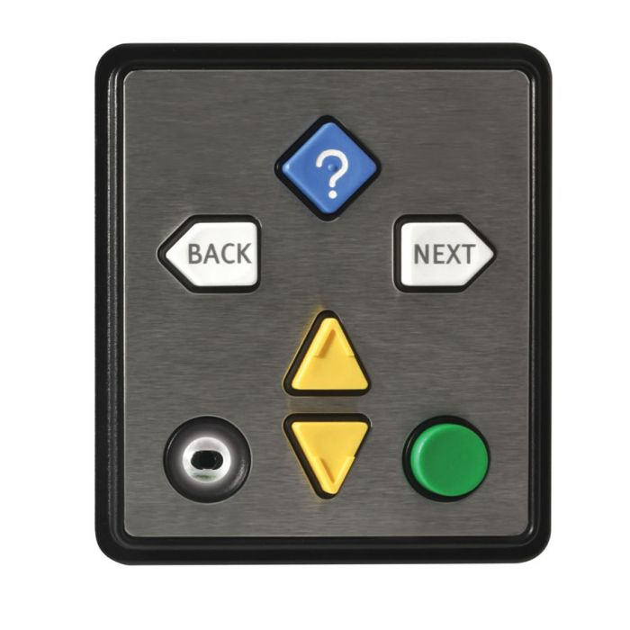
HARDWARE PRODUCTS & ADA COMPLIANCE
Storm Interactive,
Microphone Activation Sensor
Boca Systems, Lemur-Z Printer
Storm Interactive, NavPad

Slide 10
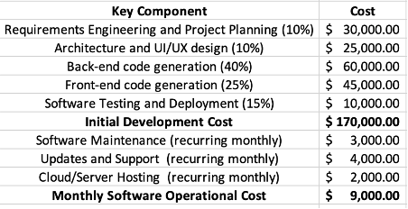
ESTIMATED COST OF SOFTWARE PRODUCTS
Notes:
Namra

Slide 11
ESTIMATED COST OF PERSONNEL
Amount | Personnel | Monthly Cost
2 | Software Developer | $13,333.33
1 | UI/UX Designer | $5,833.33
1 | Quality Assurance Engineer | $5,833.33
1 | Project Manager | $8,333.33
 | Initial Development Cost | 33,333.32
1 | Maintenance Engineer | $5,416.00
 | Ongoing Maintenance Cost | $5416.00
 | Training for End-User | $2,000
 | Training Cost | $2,000
 | Monthly Total | $40,749.32

Slide 12
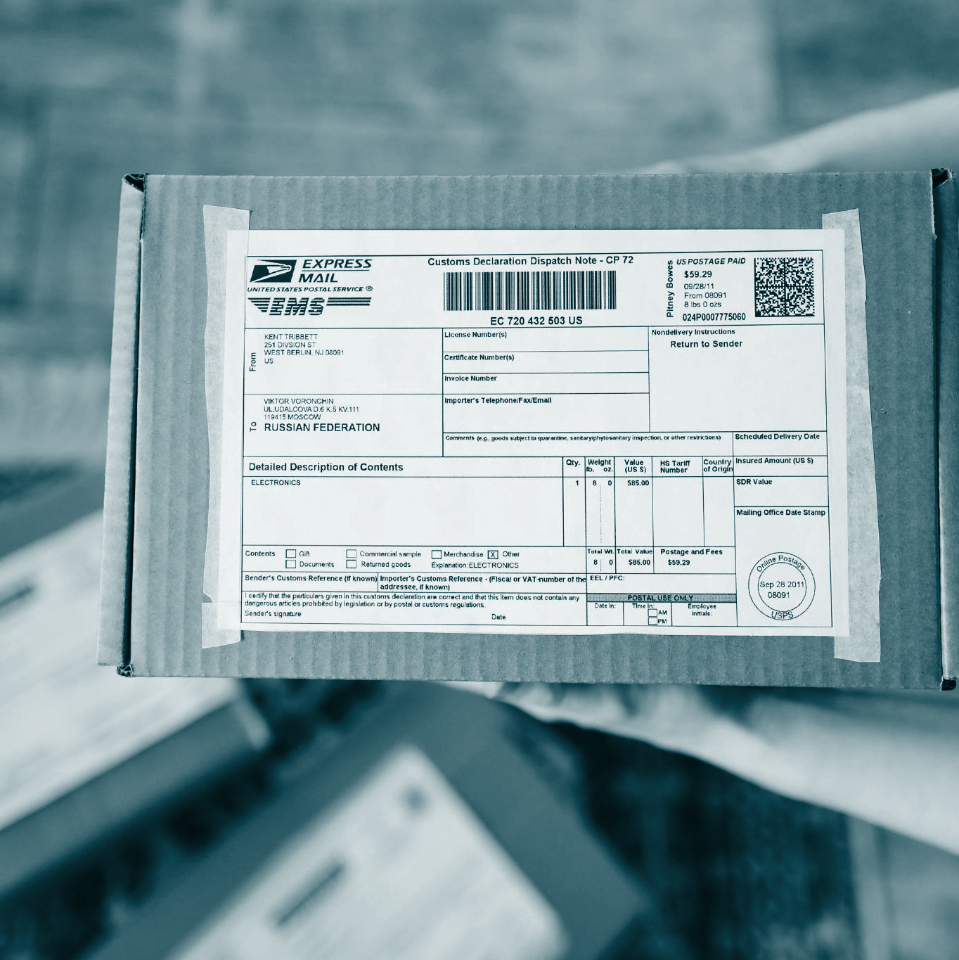
03
PROJECT TIMELINE

Slide 13
PROJECT SCHEDULING
Start Date: September 1, 2024
End Date: August 31, 2025
Duration: 12 months
*** Excluding weekends
Number of working hours per day for the project: 3-4 hours
TASK | SEP | OCT | NOV | DEC | JAN | FEB | MAR | APR | MAY | JUN | JUL | AUG
Define project’s scope and motivation
Define requirements, software process model, and architectural design
Implement prototype
Implement final software and hardware
Test in several postal offices
Receive consumer feedback

Slide 14

04
SOFTWARE REQUIREMENTS

Slide 15

SOFTWARE FUNCTIONAL REQUIREMENTS
1. User shall be able to select package type and input package dimensions.
a. Package Types: Legal Document/Flat, Small, Medium, Large, Extra Large
b. Dimensions: Length, Width, Weight
2. The system shall be able to automatically determine the package materials, from the package
specifications, and dispense the materials.
a. Materials: Cardboard Mailer, Cardboard Box, Bubble Wrap, Tape, Fragile Label
3. The system shall be able to validate an entered address for shipping.
4. The system shall be able to generate and print a valid shipping label with all necessary information.
a. Information: Mailer Information, Recipient Information, Shipping Address, Tracking Barcode
5. User shall be able to view notary availability and book an appointment.
6. The system shall be able to process multiple packages in a single continuous transaction
7. The system shall be able to calculate final cost and process payment.

Slide 16
SOFTWARE NON-FUNCTIONAL REQUIREMENTS
1. PRODUCT REQUIREMENTS
1.1 Usability Requirements | The Shipping Kiosk system should be available to all users from Monday to Friday from 8:00 AM to 8:00 PM. The Shipping Kiosks will be located in all post offices in the United States (will be expanded globally in the future). All kiosks will be self-service and have a touchscreen display. All users will be presented with a 15 second video on how to use the kiosk before beginning any transaction.
1.2 Efficiency Requirements | 1.2.1 Performance Requirements The Shipping Kiosk system should perform all processing steps (validate address and payment) within a reasonable amount of time (3-5 seconds). The system must print the shipping label and dispense packaging materials immediately for the user. The system must be able to handle a large number of transactions with little latency to promote scalability. 1.2.2 Space Requirements The database must be able to store name, address, and payment details for thousands of users (can be adjusted based on volume of customers using the software at any given time).
1.3 Dependability Requirements | The system must include provisions for real-time monitoring of software or hardware issues. If the system fails, an error message must immediately be sent to the developer team.
1.4 Security Requirements | The Shipping Kiosk system should only collect basic information from package senders (name, address, payment details). The system must securely delete that is no longer needed. The system must encrypt data (using SSL/TLS) during data transmission.

Slide 17
2. ORGANIZATIONAL REQUIREMENTS
2.1 Environmental Requirements | The Shipping Kiosk system will provide users with reusable, recyclable packaging materials and provide information about appropriate disposal. The system will calculate the smallest possible package dimensions to reduce unnecessary waste.
2.2 Operational Requirements | The Shipping Kiosk software must be checked for software/ hardware issues on a bi-weekly basis. Issues will be immediately addressed. Adequate paper for printing shipping labels must be present and replaced as needed by the post office it is placed in. The system should include customer support during all hours of operation.
2.3 Development Requirements | There should be a system to provide real-time alerts for any software or hardware malfunctions.
2. EXTERNAL REQUIREMENTS
1.1 Regulatory Requirements | The Shipping Kiosk software must follow data privacy laws for the country it is being used in (currently only in the United States). In the United States, the software must comply with data privacy laws such as the California Consumer Privacy Act (CCPA) to ensure legal access and use of users’ data.
1.2 Ethical Requirements | The Shipping Kiosk software will ensure that users are aware of exactly how their data will be used. Data will never be sold. Once no longer required for the purpose of delivering the package, the software will safely delete users’ data.
1.3 Legislative Requirements | 1.2.1 Accounting Requirements The database must contain detailed logs for all transactions. Users’ payment information must not be stored in the database. In order to scale the system globally, the system must be able to handle financial transactions with different currencies. The software must calculate shipping and packaging costs based on the users’ desired packaging materials, delivery timeline, package dimensions, and item weight. 1.2.1 Safety/Security Requirements The Shipping Kiosk system shall implement the data privacy laws of the country it is in. The system must encrypt all users’ personal identifiable data.
Notes:
Ethical Requirements
The Shipping Kiosk software will ensure that users are aware of exactly how their data will be used.
No data will be sold for any purpose.
Once no longer required for the purpose of delivering the package, the software will safely delete users’ data.
Legislative Requirements
Accounting Requirements
The database must contain detailed logs for all transactions.
Users’ payment information must not be stored in the database.
In order to scale the system globally, the system must be able to handle financial transactions with different currencies.
The software must calculate shipping and packaging costs based on the users’ desired packaging materials, delivery timeline, package dimensions, and item weight.
Safety/security Requirements
The Shipping Kiosk system shall implement the data privacy laws of the country it is in.
The system must encrypt all users’ personal identifiable data.

Slide 18

05
SOFTWARE DESIGN ARTIFACTS

Slide 19
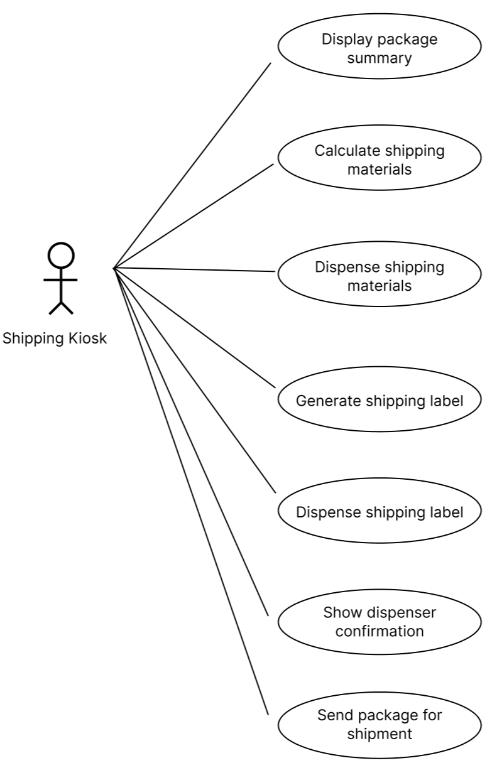
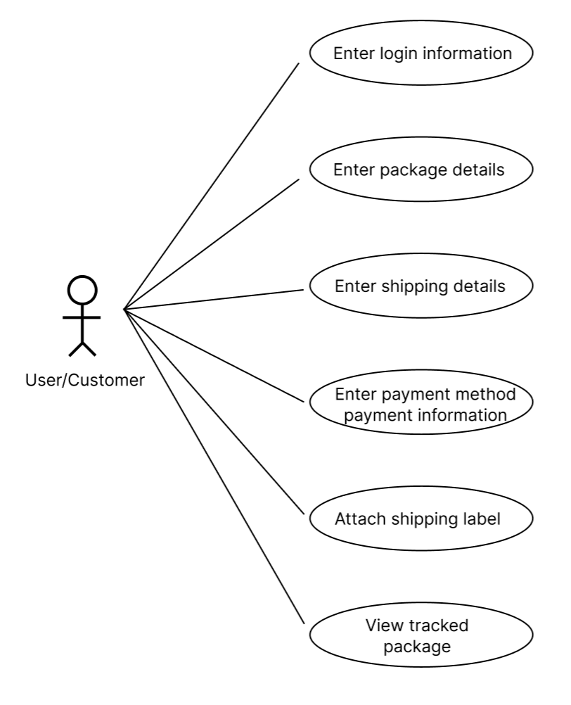
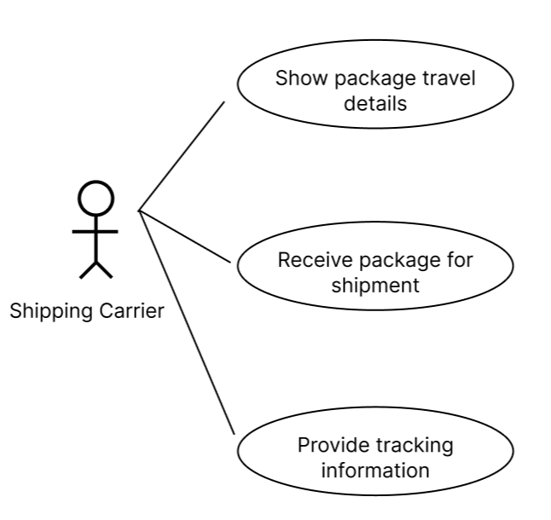
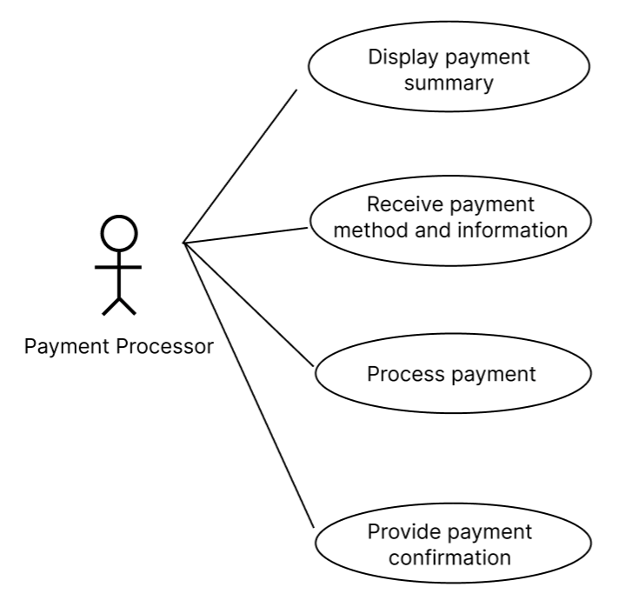
USE CASE DIAGRAM

Slide 20
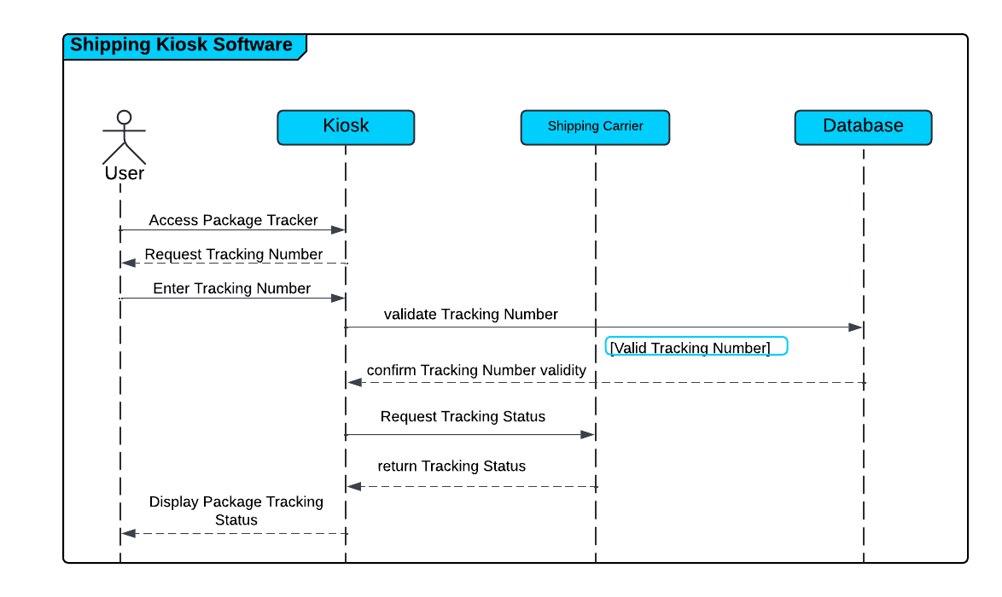
SEQUENCE DIAGRAM

Slide 21
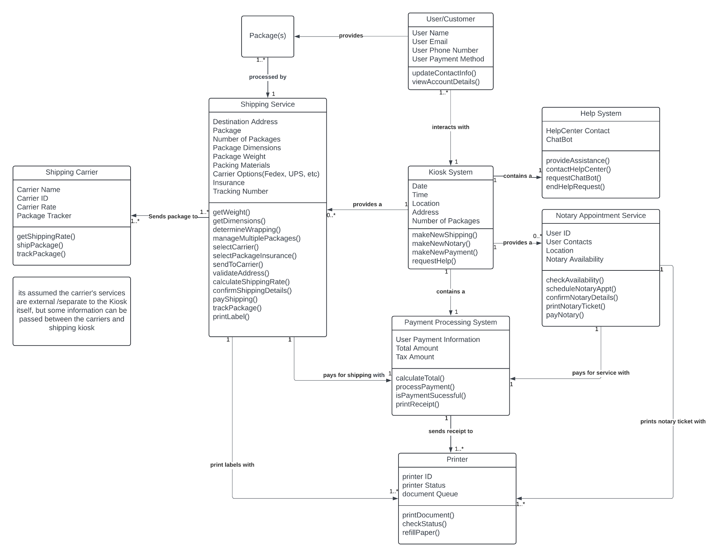
CLASS DIAGRAM

Slide 22
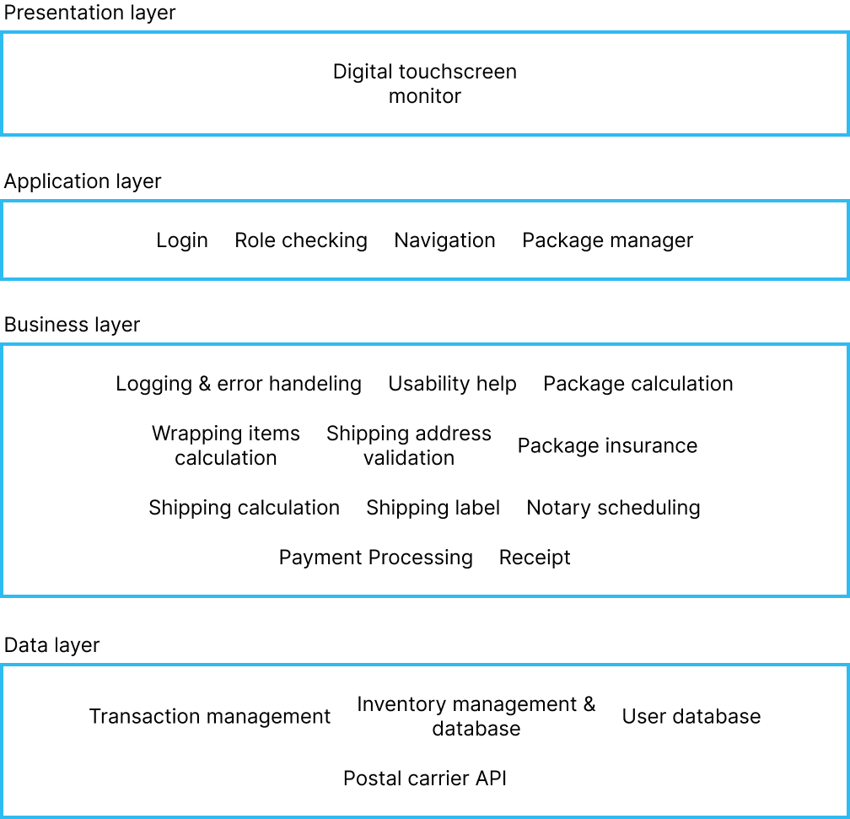
LAYERED ARCHITECTURE PATTERN

Slide 23
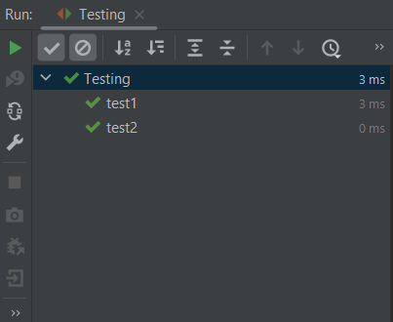
SOFTWARE TESTING
Unit Testing: Black-Box Testing Techniques (Cause & Effect)
Integration Testing: Regression Testing w/ JUnit
Validation Testing: Beta Testing

Slide 24

06
UI DEMO

Slide 25
UI Demo Prototype
Prototype link
Notes:
https://www.figma.com/proto/gOK1JWL2wA1wNiBjBg6OCz/CS3354-ShippingKiosk?node-id=2-2&node-type=canvas&t=ThKF8tqxYsu4BIrx-1&scaling=scale-down&content-scaling=fixed&page-id=0%3A1&starting-point-node-id=2%3A2

Slide 26
07
CONCLUSION

Slide 27
Challenges
Changes
Notes:
https://www.figma.com/proto/gOK1JWL2wA1wNiBjBg6OCz/CS3354-ShippingKiosk?node-id=2-2&node-type=canvas&t=ThKF8tqxYsu4BIrx-1&scaling=scale-down&content-scaling=fixed&page-id=0%3A1&starting-point-node-id=2%3A2

Slide 28
Thank you for listening!
Do you have any questions?
Please keep this slide for attribution

